Slide 1
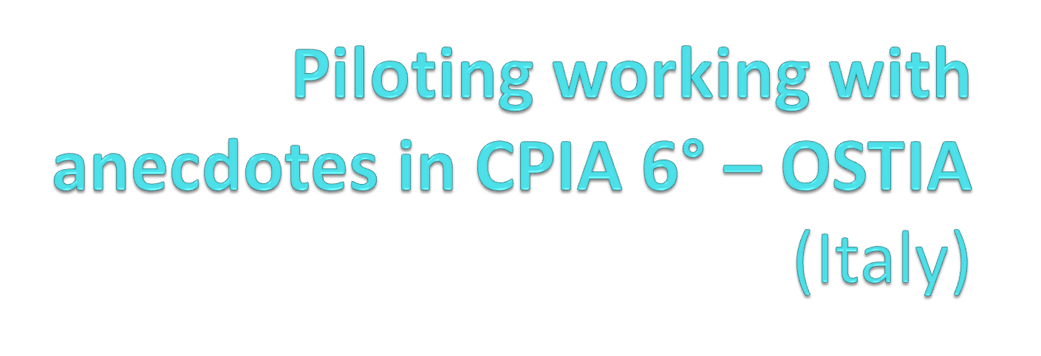

Slide 2


WE ARE...
Europe :1 0 Italian 3 Spanish 3 Moldavian 3 Russian 2 Polish 2 Romanian 4Ukraine 1 Lithuanian 1Turkish
Africa: 3 Senegal 3 Mali 1 Zimbabwe 1 Burkina Faso 3 Egypt, 1 Guinean
Asia:2 Chinese 2 Bangladesh 3Pakistan 1 Sri Lanka
America: 1 Canadian 2 Cuba 3 Colombian 1 Costa Rica 1 Argentinian 2 Brazilian

Slide 3
TELLING ANECDOTES
THE GOALS:
Improving speaking and writing skills and relationship with others
Sharing a story above all if it is personal tells more about the student and this is a little brick towards building relationship with the other people who are listening, hence promoting social inclusion as well as combining social inclusion and L2.

Slide 4
CONNECTING FL WITH NFL
This non formal activity is good to link formal learning to the real world: during the narration of the anecdotes some slang language came up and so the teachers have the opportunity to link formal and non formal language.
It is also a chance to speak about difficulties that many foreigners find when they arrive in a new country, without anxiety in a relax and festive way.
Writing and correcting all together with the students permits to deal with grammar and to reinforce knowledge that has already been acquired. It is a very good tool in multilevel classroom.
Telling your own anecdotes to groups of people who are mother tongue Italians facilitates social inclusion

Slide 5
WHAT YOU NEED TO DO THIS ACTIVITY
It is best to have...
A GOOD SENSE OF HUMOUR
LOTS OF SOCIABILITY
AVAILABILITY TO PLAYING GAMES
WILL TO SHARE
A LITTLE BIT OF MOTIVATION
A GOOD RELATIONSHIP BETWEEN CLASSMATE AND TEACHERS (BUT THIS IS ALSO ONE OF THE GOALS)
NOT MUCH... It is an activity easy to organize, you do not need specific material, just a group of students and...
SOME SPACE
A PAPER, A PEN
LIM BOARD ,BLACKBOARD OR LARGE SHEET FO PAPER TO WRITE ON AND TO SHOW EVERYBODY
A CAMERA IF YOU WANT TO TAKE PICTURES OR A VIDEO OF THE PERFORMANCE
AN INTERNET CONNECTION TO SHOW SOME VIDEOS

Slide 6
TARGET GROUP
One group was secondary school level: 6 men 4 women. Different ages, from 24 to 70. Different levels of education, from primary school to a university degree. Really interested in all the activities .
A group B1 level. Ten students over 27 years of age. Mostly women with a high level of education. At the beginning it was quite difficult for the students to talk about their private life with their classmates. After the teachers themselves had revealed funny anecdotes from their own private life , the students felt more comfortable and didn't feel judged anymore. Finally they started talking about funny little stories that had happened and then were able to laugh at each other's stories.
Group A1 level ; Ten young adults from different countries. In this group they dramatised the anecdotes, because it was difficult for them to explain by just using words. The teachers used a mime game and hand language to encourage them
Group A1 level 2. Twelve young adults with a low level of education , mostly
refugees from Africa. They immediately appreciated doing the work and were very collaborative . A group of them came from the same immigration center, so they knew each other and together they helped each other to narrate their stories. The teachers proposed videos in the Italian language with subtitles of these anecdotes which were certainly enjoyed.
Group A2/B1 Five young adults . Intermediate level of education . They were used to have formal lesson. At the beginning they didn't want to participate because they considered a waste of time doing this activity and they preferred to have grammar lesson. Then the teacher spent some time explaining that was an exercise to improve speaking skills and during the writing anecdotes a lot of time was spent to make clear the grammar language mistake.
Group Secondary high school education. Italian and foreigner students (with high level of Italian language). Twelve student with different ages, from 16 to 60, mostly women. Really interested in all the activities, overall during the exchange experiences with students of learning Italian group.

Slide 7
THE STEPS: A2-B1-B2-C2
Anecdotes
Fase1: samples from the teacher to the students
Fase2: telling anecdotes
Fase3: writing anecdotes
Fase4: correcting them together with the students
Fase5: Mixing the foreign group with Italian students
Fase6: Telling each other their anecdotes

Slide 8
THE STEPS: A1- A1/A2
Anecdotes
Fase1: mime game
Fase2: teachers tell anecdotes with mime and body language
Fase3: telling anecdotes
Fase4: writing anecdotes all together with the teacher
Fase5: Mixing the foreign group with Italian students
Fase6: Telling each other their anecdotes

Slide 9
What did the teachers learn?
To get to know our students better
Very funny stories
To teach idiomatic language: essential and unavoidable
Exchanging ways of teaching
Find new ideas to develop with other students ( gathering together all the anecdotes they wrote or the idea of writing a little dictionary for survival while shopping around the food markets in Rome).

Slide 10
What did the students learn?
In the short term they improve their language, both generally and specifically speaking (regarding cousine, food)
They reinforce what they already know.
Speaking skills are improved.
They also improve their self confidence while speaking as well as relating with others.

Slide 11
WHAT DID THEY BOTH LEARNED
Cooperative learning and the importance of autocorrection in the process of learning.
The peer-to-peer experience of the student in their exchanges of each other's personal experiences.
To get to know better each other

Slide 12
SOCIAL INCLUSION
Creating a relaxing atmosphere through party-food and drinks, the students were more available to communicate with each other.
It was easier to get to know each other and exchange telephone numbers or facebook contacts (mostly to get advice or info about a job offer or information about flat to rent).
This means mixing people from different countries, different ages and different interests.
Some students with overall low accademic levels, were really shy and not confident while speaking Italian. They became more active and confident in speaking during these activities.
Some students found them interesting and useful because it was a way not to feel alone and start to understand that some difficulties and problems in a foreign country are common when it comes to socialising with other people. It also made clear that they can be part of Italian society, by getting together with other Italian students. Some students were really curious to listen to the other people's stories, comparing their own realities with those of the others. It was a way to feel linked with their new friends.

Slide 13
CRITICAL POINTS
1. Do your students feel unconfortable talking about their private lives?
The teachers can try to reveal funny and really personal anecdotes from their own private life , so that the students can feel more comfortable and don't feel judged anymore .
Do your students have very low language skills?
The teachers can propose a mime game and watch videos…and no one is oblidged to partecipate. Can also be interesting to work with several anecdotes
Do your student think this experience is waste of time? Do they prefer grammar lessons? Explain to them that this is an exercise to improve their speaking skills and reinforce the grammar …
…try to change your way of teaching!

Slide 14
Is it for everybody? Can be repeated and adapted ?
Everybody can afford the activity " telling anecdotes".
It is important to build a positive relationship between teacher and students, for the latter to feel comfortable and motivated enough to share their personal stories.
With lower level (A1), the work can be more difficult. In these cases, a miming game can help students to tell their anecdote through words and body language (which is an important part of the Italian culture and language as well!)
Could be a single event ; you can spend just one lesson an hour on it: 10 minutes for example from the teachers and 10 minutes to think: 30 minutes to tell the story . But if you want to write and correct all the anecdotes, together there is more time, depending on number of people.
Could be a series of events,.so the student can repeat the experience and also during their stay at home think about other stories to tell ; then you can have one or more meetings to share.
Having a database of anecdotes can be helpful for future reference.

Slide 15
A NEW IDEA FOR THE FUTURE…
ANECDOTES AND STORYTELLING…
Organizing creative writing lab with foreign students,not just with the writing but sceneggiature e forme espressive legte alle arti visive viedeo e foyto e linguaggio musicale aboveall with second generation immigrants r
Nei ragazzi di 2 generazione o agli stranieri che lontanidalla terra di orgini

Slide 16
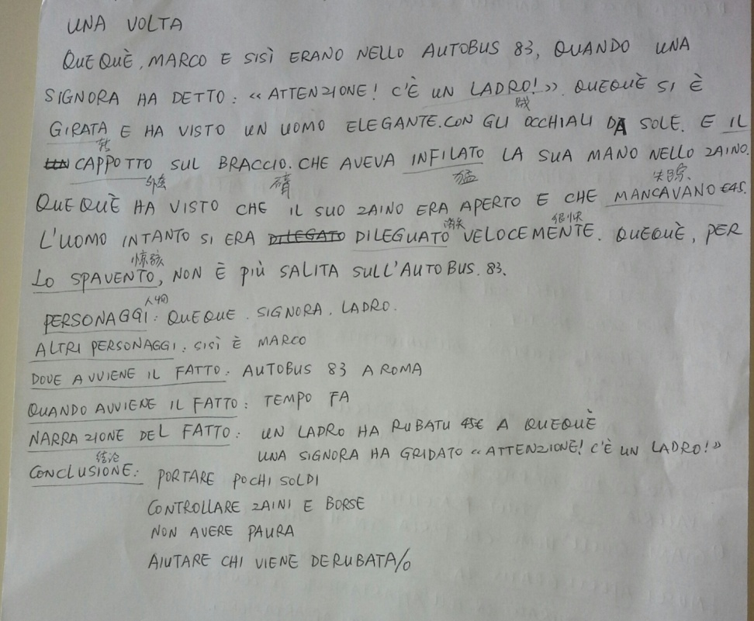
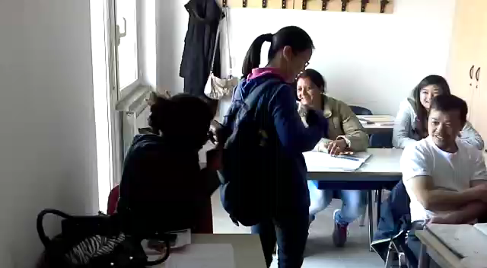
Attenti al ladro!

Slide 17


2 SPAGHETTI OR DUE SPAGHETTI

Slide 18
The story
When I arrived in Italy I started to work as a caregiver for an old lady. One day, her son Gianluca said to me, " Could you please cook due spaghetti for dinner?"
I put a pot of salted water to boil on the stove as they has taught me to do, then I took two spaghetti and boiled "them". I didn' t understand how "two spaghetti" could be enough For the dinner of Three People.
When Gianluca realised what I had done, he started to laugh and then explained to me that "due spaghetti" meant a Little bit or small quantity of pasta!
That night we had salad For dinner!!

Slide 19
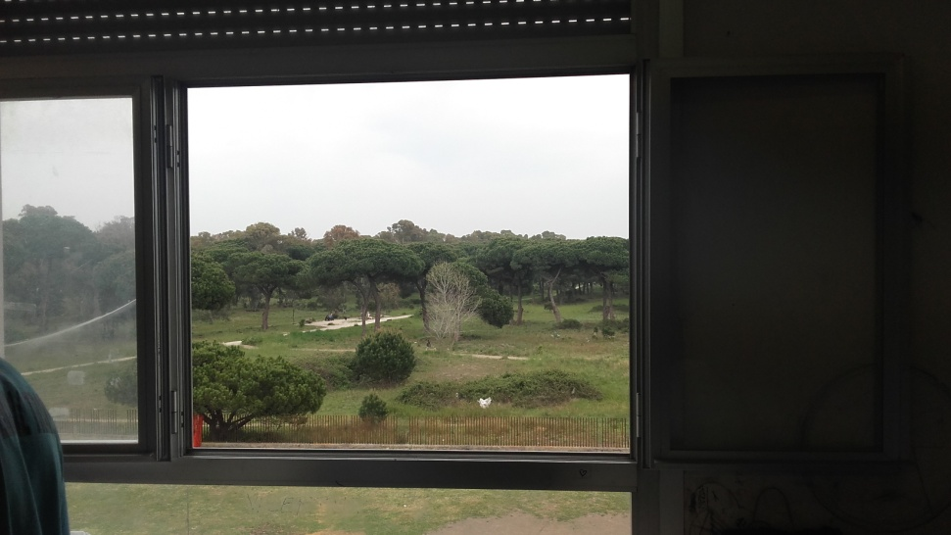
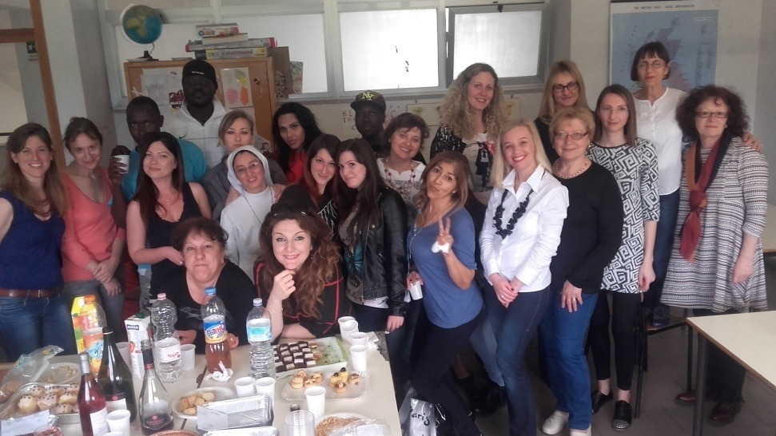
When? – Where?
February – May
During class

Slide 20
Why will we go on?
Mixing Italian and foreign people
Enjoyment in the classroom
Exchanging experiences
Cooperative learning-autocorrecting
Improving speaking skills ability

Slide 21
What did the teachers learn?
To get to know better our students
Very funny stories
To teach idiomatic language: essential and unavoidable
Exchanging ways of teaching
Ideas to encourage the use of a personalized dictionary for everyday use

Slide 22
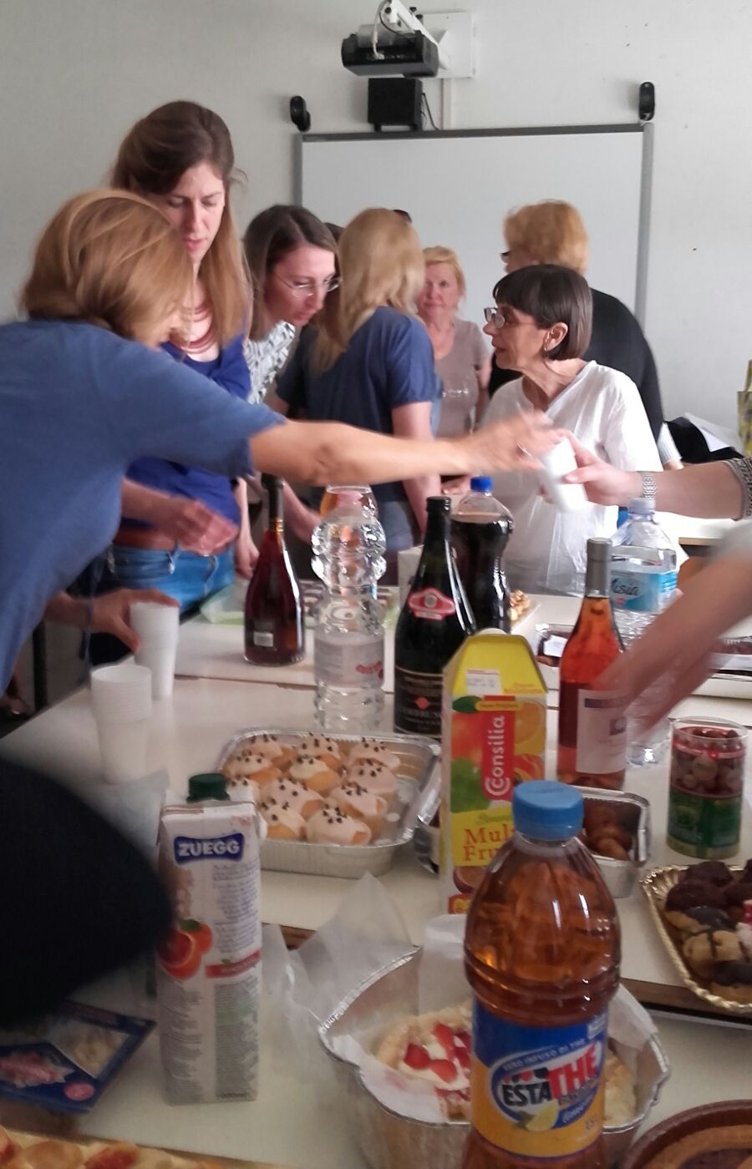
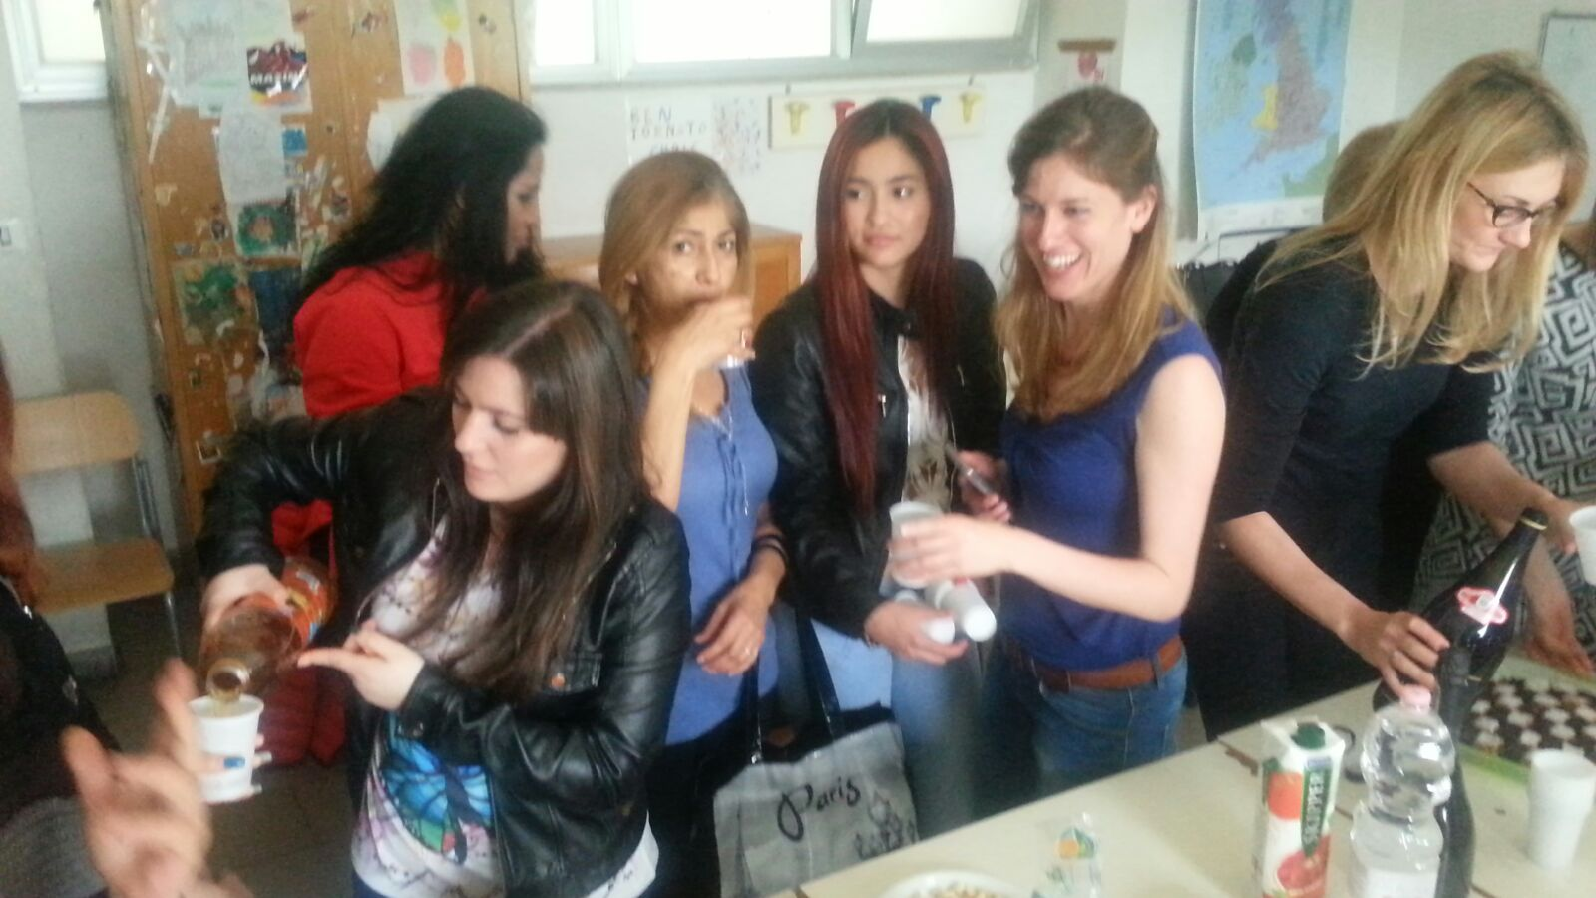
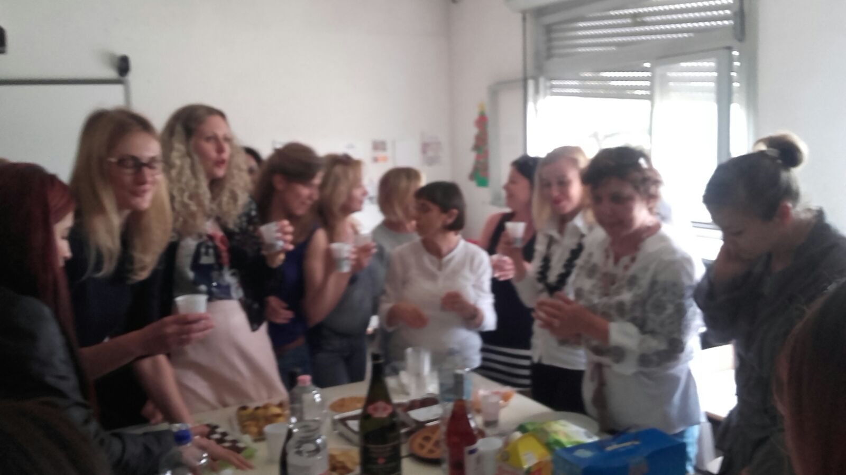
Celebrating anecdotes!

